Slide 1
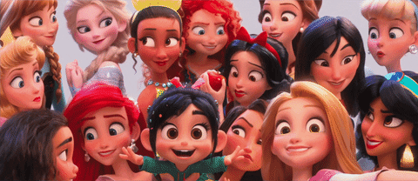
"A Whole New World": Redefining Gender in Disney Films from the 20th to 21st Century
Shrien Alshabasy

Slide 2
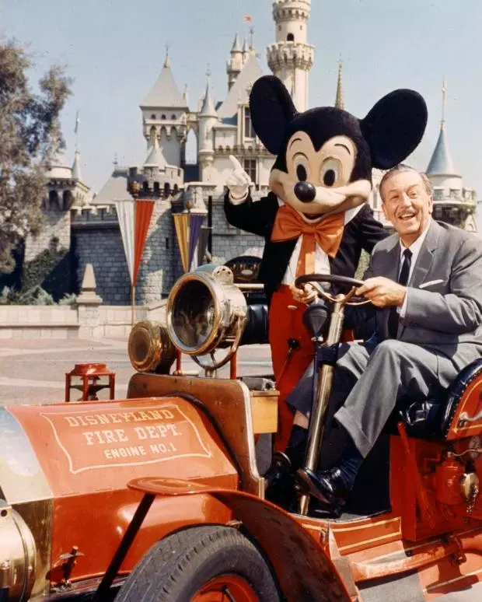
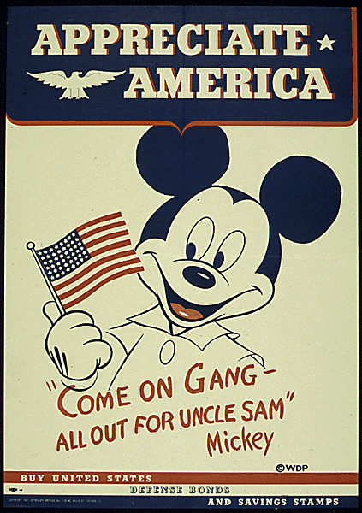
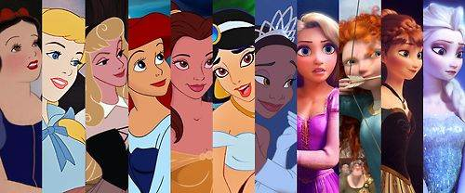
Why Disney?
Disney is a manifestation of American ideology -- a stable understanding of American values even during unsettling times.

Slide 3
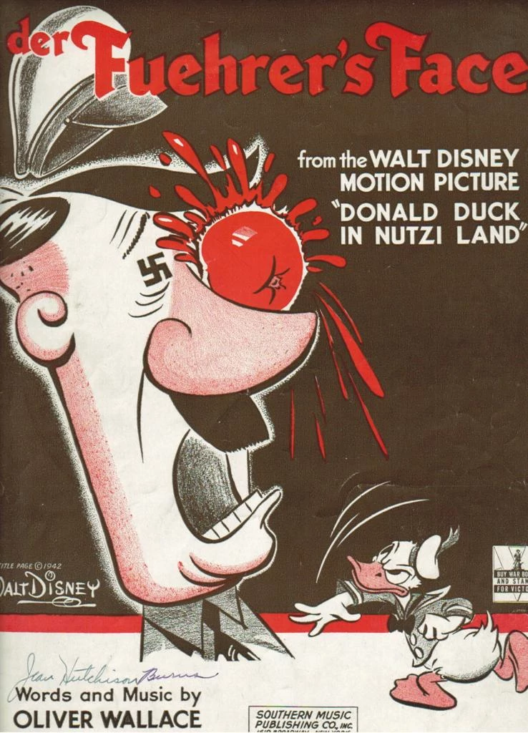

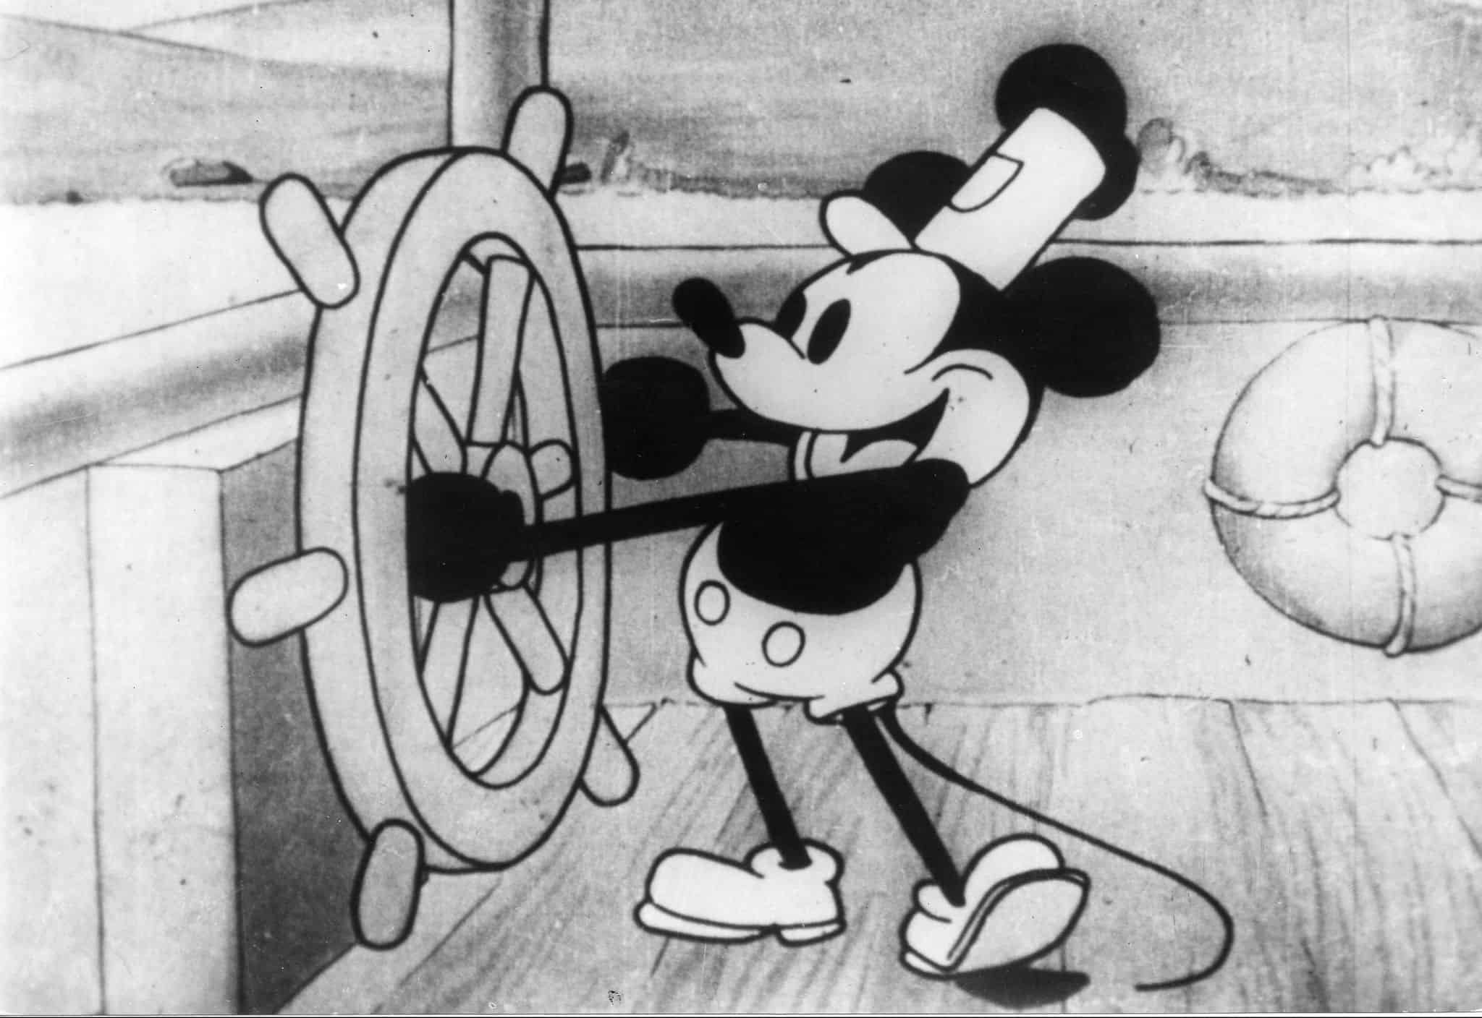
Disney as a political tool.

Slide 4
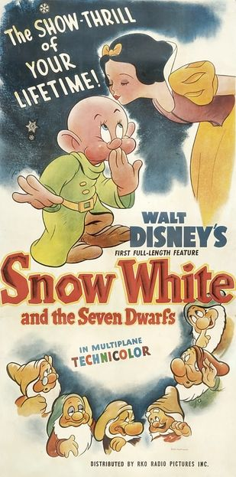
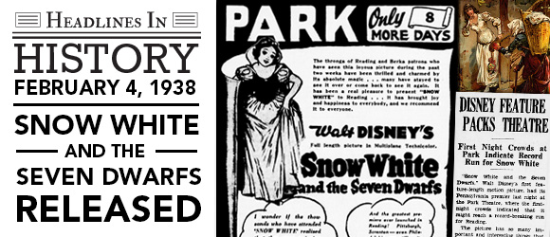
In 1938, Disney shifted gears into feature films with his vision of Snow White and the Seven Dwarfs. Although many had their doubts, after three years of work Snow White was released and it quickly became the highest grossing film of all time.

Slide 5
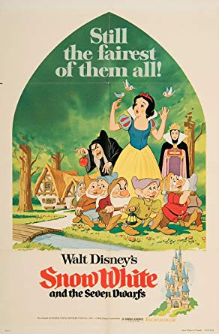
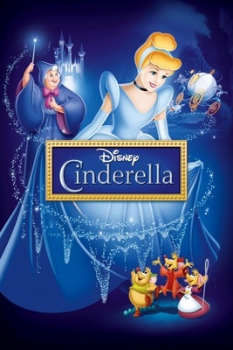
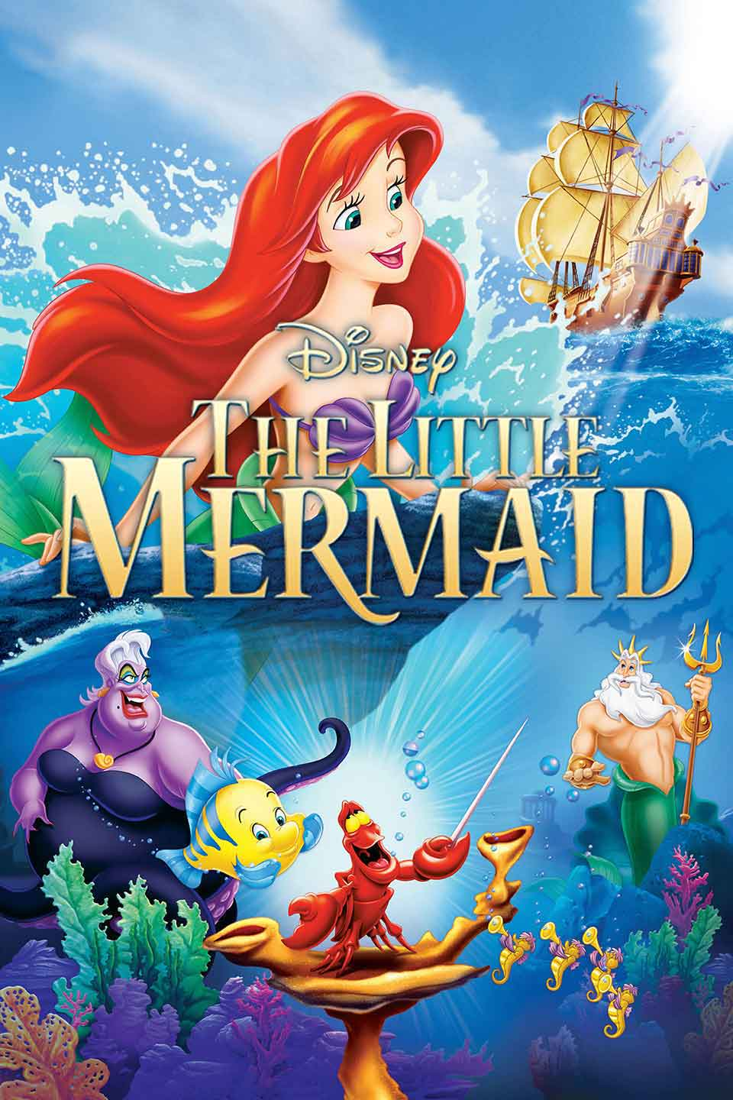
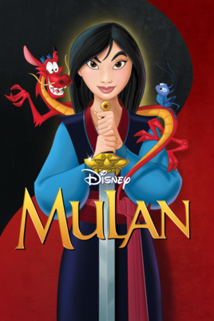
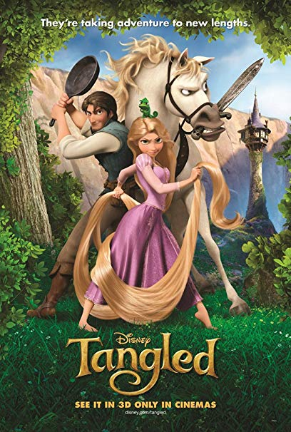

In my paper, I examine the way that 21st Century Disney films in the Revival Era resist (and sometimes participate) in social structures relating to the male gaze, the myth of womanly masks and notions of True Womanhood. I will examine Disney’s shift toward more progressive gender politics through three lenses: Lauren Mulvey’s analysis of the male gaze, Gilbert and Gubar’s theorization of womanly masks and Barber Welter’s tenets of True Womanhood.

Slide 6
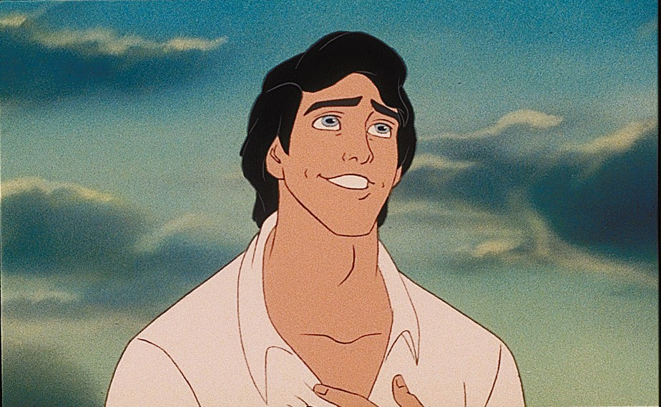
Three Primary Lenses and Theories
In her article “Visual Pleasure and Narrative Cinema,” Laura Mulvey argues that the male audience takes pleasure in watching both female and male subjects on the screen. In her critique of cinema, Mulvey argues that film replicates power dynamics embodied in reality. The cinema offers pleasure to viewers, and male centered desires are usually the premise of a film.
Laura Mulvey's "Visual Desire and Narrative Cinema.”

Slide 7
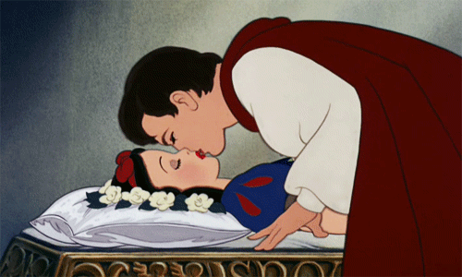
Visual Desire and Narrative Cinema in Snow White
In Snow White, the male gaze is fulfilled through the depiction of the domesticized Snow White and the heroic Prince. The Prince does not have many speaking lines in the film, and it is this stoicism that characterizes his confidence - he does not need to fret or outwardly chase Snow White.

Slide 8
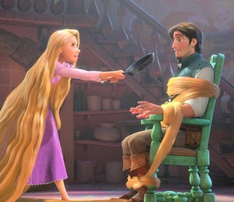
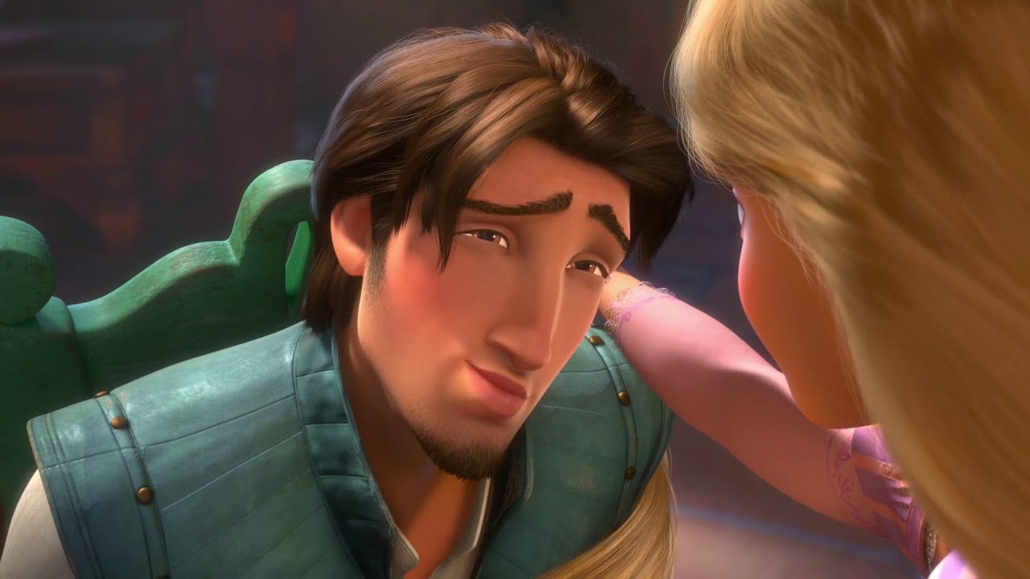
Visual Desire in Tangled
Rapunzel disengages with fulfilling the male gaze by trivializing Flynn Rider’s importance and adopting the role of hero in her narrative.
Notes:
Tangled came out during a distinct shift in Disney’s agenda. Although princesses have become iconic figures in the Disney portfolio, box office numbers are pointing to a 21st century shift away from hyper-feminine princess characters, exemplified in the popularization of new Disney figures such as Buzz Lightyear, Woody, Jack Sparrow and other superheroes. The film’s shift away from the traditional princess formula is seen through the characterization of Rapunzel - she publicly and adamantly desires her own freedom, pursues the outside world despite her stepmother’s orders, rescues Flynn in almost every situation, trivializes his masculinity and wields her femininity as a weapon to deconstruct traditional hyper masculine spaces. There is no doubt that the film is progressive in regards to the Disney canon of princess films, but there are still limitations concerning the storytelling presence and narrative control of the story, perpetually and seemingly purposefully hijacked by Flynn Rider, the male “hero.”
When he scales the castle, Rapunzel hits the unwelcome intruder and ties him up with her hair, weaponizing an attribute commonly associated with feminine beauty and, in Rapunzel’s case, social control.
Rapunzel also represents the cunningness and manipulation -- she steals Flynn’s satchel when he is passed out and negotiates with him in order to equalize the power dynamic, “You will act as my guide, Take me to these lanterns, and return me home safely. Then, and only then, will I return your satchel to you.”
When he smolders at her in order to persuade her to return his satchel, she raises a confused eyebrow at him, unmoved. Flynn, surprised by her reaction, says “This is kind of an off day for me. This doesn't normally happen.” Rapunzel deconstructs the ego manifested in male characters by remaining grounded in her desire, resisting a man’s romantic manipulations in order to remain in control.

Slide 9
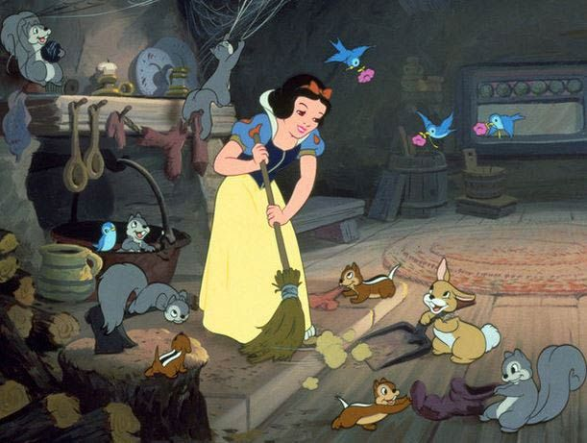
Three Primary Lenses and Theories
In 20th century Disney Princess films, the stoic, confident Prince figure is constructed as the more ideal version of a man who is struggling through the mirror stage. Similarly, the depiction of domesticized Disney Princesses embody Barbara Welter’s conceptualization of the True Woman, a woman who’s virtue and morality remains untainted by temptations, which contributes to her physical beauty and romantic attainment.
2. True Womanhood by Barbara Welter

Slide 10
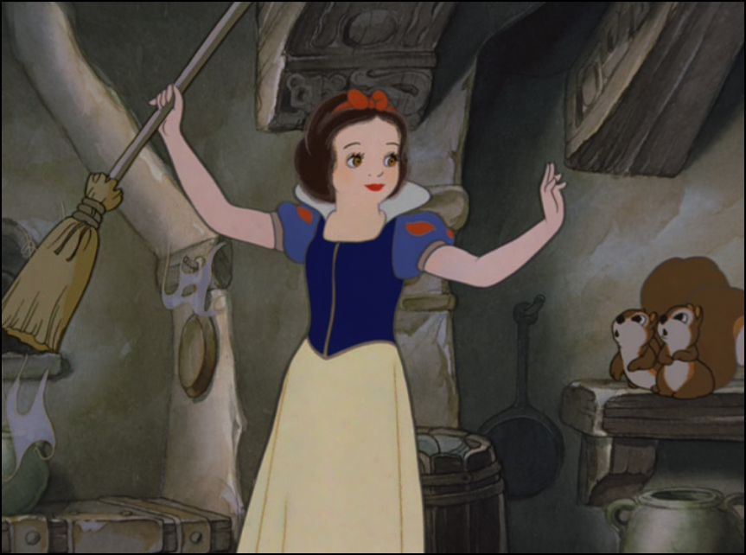
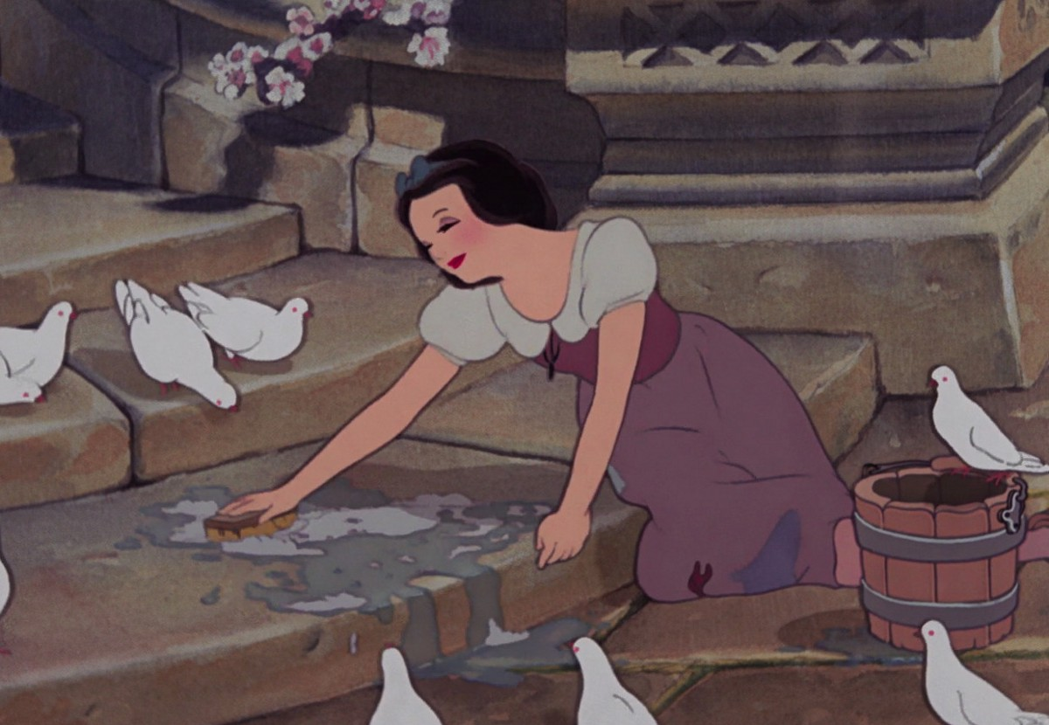
True Womanhood in Snow White
Snow White’s happiness with performing her domestic duties is rewarded through her physical attractiveness, a gendered trait that makes her the target for the Evil Queen’s maliciousness.
Notes:
Snow White sits close to her domestic sphere and even cleans the spillage from the fountain, with no expression of desire to wander outside the confinements of her garden, a place of social control. In “The Cult of True Womanhood,” Barbara Welter argues that a woman’s placement in the domestic sphere was important for controlling her virtue, as “‘the true dignity and beauty of the female character seem to consist in a right understanding and faithful and cheerful performance of social and family duties’” (Welter 162).
When Snow White arrives in the home of the dwarves, their initial detestation of her comes from their belief that she is impure or a temptress. Without her relationship with the domestic space, Snow White’s womanhood is questioned and she temporarily dons the evil mask of other unwomanly characters,

Slide 11
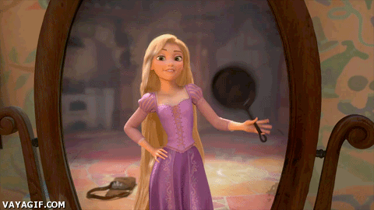
True Womanhood in Tangled
Unlike Snow White, Rapunzel is not content with her role as a domestic servant. Rapunzel finds her role in the castle distasteful, a reversal of the trope of the submissive True Woman, who is “expected to realize [her] primary identity within the domestic sphere as wives, mothers and housekeepers” (Delikonstantinidou 54)
Notes:
Unlike Snow White, Rapunzel is not content with her role as a domestic servant. Rapunzel finds her role in the castle distasteful, a reversal of the trope of the submissive True Woman, who is “expected to realize [her] primary identity within the domestic sphere as wives, mothers and housekeepers” (Delikonstantinidou 54) Rapunzel finds cleaning and stereotypical feminine activities like knitting, cooking, and candle making boring as she wonders “when will my life, begin?” Rapunzel’s boredom with traditional domestic duties is representative of the fear that many had in the nineteenth century regarding women and their desire to roam. The ideology of the True Woman was created to “control the social transformation of American middle-class women who...had too much knowledge and too much free time...it sought to...reverse the tide that had been set in motion after decades of feminist struggle to untie women from the private sphere of the home and widen their choices and opportunities” (Delikonstantinidou 56). Rapunzel also differs from her other Disney counterparts not only in denying the myth of true womanhood, but in her ability to reclaim femininity in an empowering, instead of subjugated, way. While Snow White is seen as a “wicked wile” when she enters the dwarves home, a woman who is likely to trick the men with her charming looks, when Flynn discovers Rapunzel’s healing, magical hair, he revers her power instead of demonizing or fearing it.

Slide 12
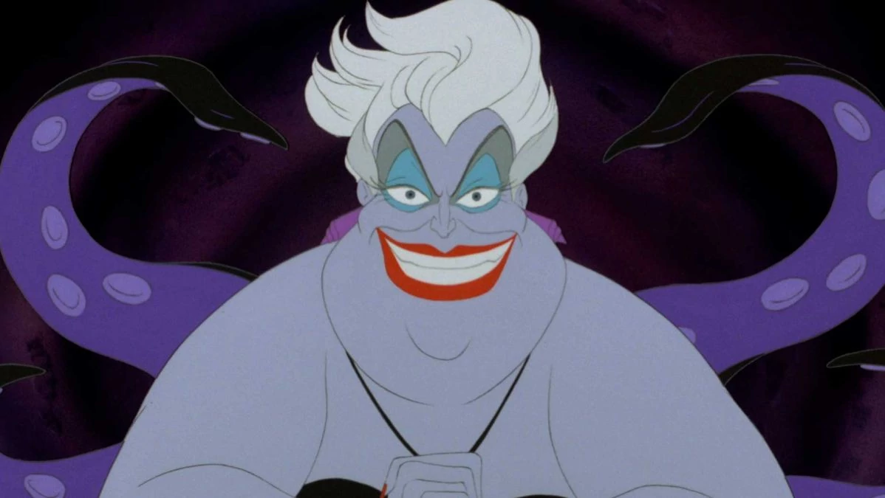
Three Primary Lenses and Theories
The idea of womanly masks in Disney is seen through the dichotomic characterization of women characters --- there is the evil stepmom/queen and the virtuous princess/soon-to-be princess. These masks are reinforced in Disney Princess films by the trope of the True Woman -- True Woman wear angelic masks, while untrue woman wear the evil masks. At the core of both the idealization of the angelic, true woman is the patriarchal order and the male gaze, forces that receive pleasure from seeing women simplified and restrained in a domestic sphere.
3. Gilbert and Gubar’s Womanly Masks

Slide 13
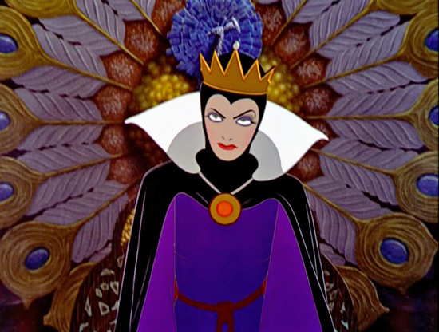
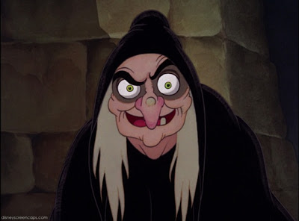
Womanly Masks in Snow White
Womanly masks are present in Snow White through the dichotomization of Snow White and the Evil Queen. In this film, the Evil Queen dons the monster mask that Gilbert and Gubar propose, and her knowledge of her placement in society inverts the tenets of True Womanhood and thus makes her evil.
Notes:
The Queen’s ability to transform provides a stark contrast to Snow White, the virginal character who cannot move between spaces. This is seen when the Evil Queen morphs into a beggar before she tricks Snow White, “‘now, a formula to transform my beauty into ugliness. Change my queenly raiment to a peddler's cloak. ‘Mummy Dust’ to make me old. To shroud my clothes, the black of night. To age my voice, an old hag's cackle. To whiten my hair, a scream of fright.’” The ability to transform is not only reflective of the Evil Queen’s wickedness (aligned here with dark magic) but her acknowledgement of appearance as an important facet of her existence as a woman. This knowledge allows the Evil Queen to attain an agency that Snow White does not, but her “‘unnatural’ craftiness must be punished with death because it is an expression of her physicality and her assertive creative energy” (Bacchilega 3). The Evil Queen is demonized because of her knowledge but also because her beliefs are at odds with the angelic mask of True Womanhood. She tempts virginal Snow White’s pious nature with the poisoned apple, “‘It's apple pies that make the menfolks' mouths water. Pies made from apples like these.” “Oh, they do look delicious.” “Yes! But wait 'til you taste one, dearie. Like to try one? Hmm? Go on. Go on, have a bite.’” The Queen is masculinized through her evil ways, tempting Snow White’s sensual nature (“menfolks mouth water”), aware that although Snow White appears pious, she, like every being, can be tempted. Snow White must meet her death after accepting the apple because she defies the tenets of True Womanhood, “all True Women were urged, in the strongest possible terms, to maintain their virtue, although men, being by nature more sensual than they, would try to assault it” (Welter 155). In this way, the Evil Queen adopts the usually masculine position of the tempter and reveals the weaknesses in the angelic masks that women wear.

Slide 14
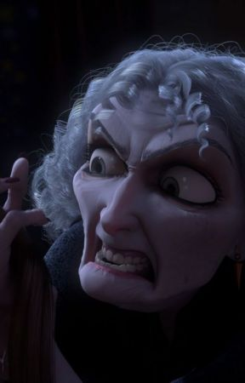
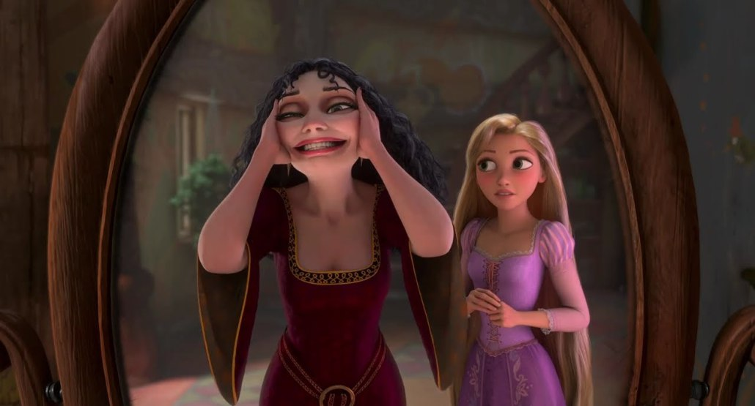
Womanly Masks in Tangled
In Tangled, Rapunzel’s stepmother Goethe is the evil female character, locking away Rapunzel in a tower in order to keep her from discovering the outside world. However, it is interesting that Goethe, like many Disney female villains, is demonized not because of her malicious intent - but rather initially because of her appearance, her age and her ability to understand and manipulate her placement as a woman in the patriarchal structure.
Notes:
The demonizing of these female characters argue that although Disney has come a long way in casting more agent female characters, there is a limit to their ability to dispose of ideologically constructed mythic masks that “male artists have fastened over her human face both to lessen their dread of her ‘inconstancy’ and by identifying her with the ‘eternal types’ they have themselves invented to possess her more thoroughly” (Gilbert and Gubar 811). This desire to simplify women into “evil” and “good” is not only a manifestation of the patriarchal gaze, but the associated attributes of these women represent the system of value that women are meant to understand and participate in. Goethe is trapping Rapunzel in the tower not solely to hide her hair from the world, but to keep herself from growing old, an anxiety that is manifested in the start of the film through her plucking of magical flowers to keep her youth intact. Instead of creating a redeeming narrative for Goethe by deconstructing her indoctrination into the idea that an older woman is not valuable, the film decides to villainize her insecurity and kill her off at the end. Although Gilbert and Gubar categorize the “monster woman” as a villainous creation of the patriarchal order that must be murdered, it is interesting to see that although Goethe is evil, she is aware of the world around her and her placement within it, affording her an intelligence and agency that Rapunzel does not have. Although misguided, Goethe’s criticisms of Flynn point out larger structural flaws in patriarchal heterosexual relationships, making her aware of the place that Rapunzel inhabits
Like Snow White, Tangled’s evil female character embodies the patriarchal belief that younger women are more valuable than older women and that older women are constantly striving to retain their youth as an economy in a hypersexualized world. he over simplified dichotomization of female characters is a product of a patriarchal ideology and harms rather than helps women in their development.

Slide 15
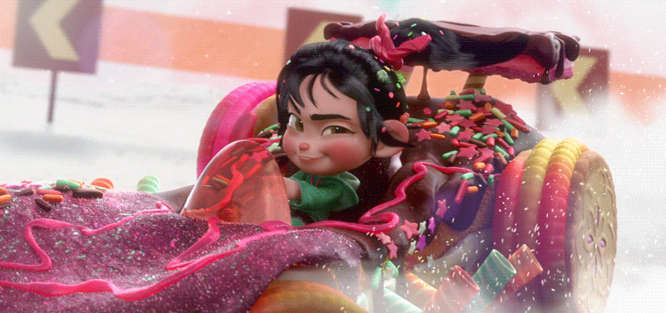
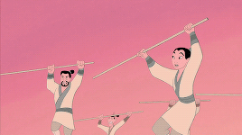

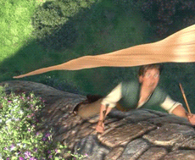
A New Disney Princess: Potential and Limitations
Comparing the passive, domestic princesses seen in 20th century films like Snow White and Cinderella to the adventurous, courageous heroines in Mulan, Tangled and Brave it is clear that this shift is an illustration of changing ideological expectations and consumer desires. → However Disney is still an investment driven conglomerate that operates off of specific class desires → limiting empowerment to a neoliberal framework.

Slide 16
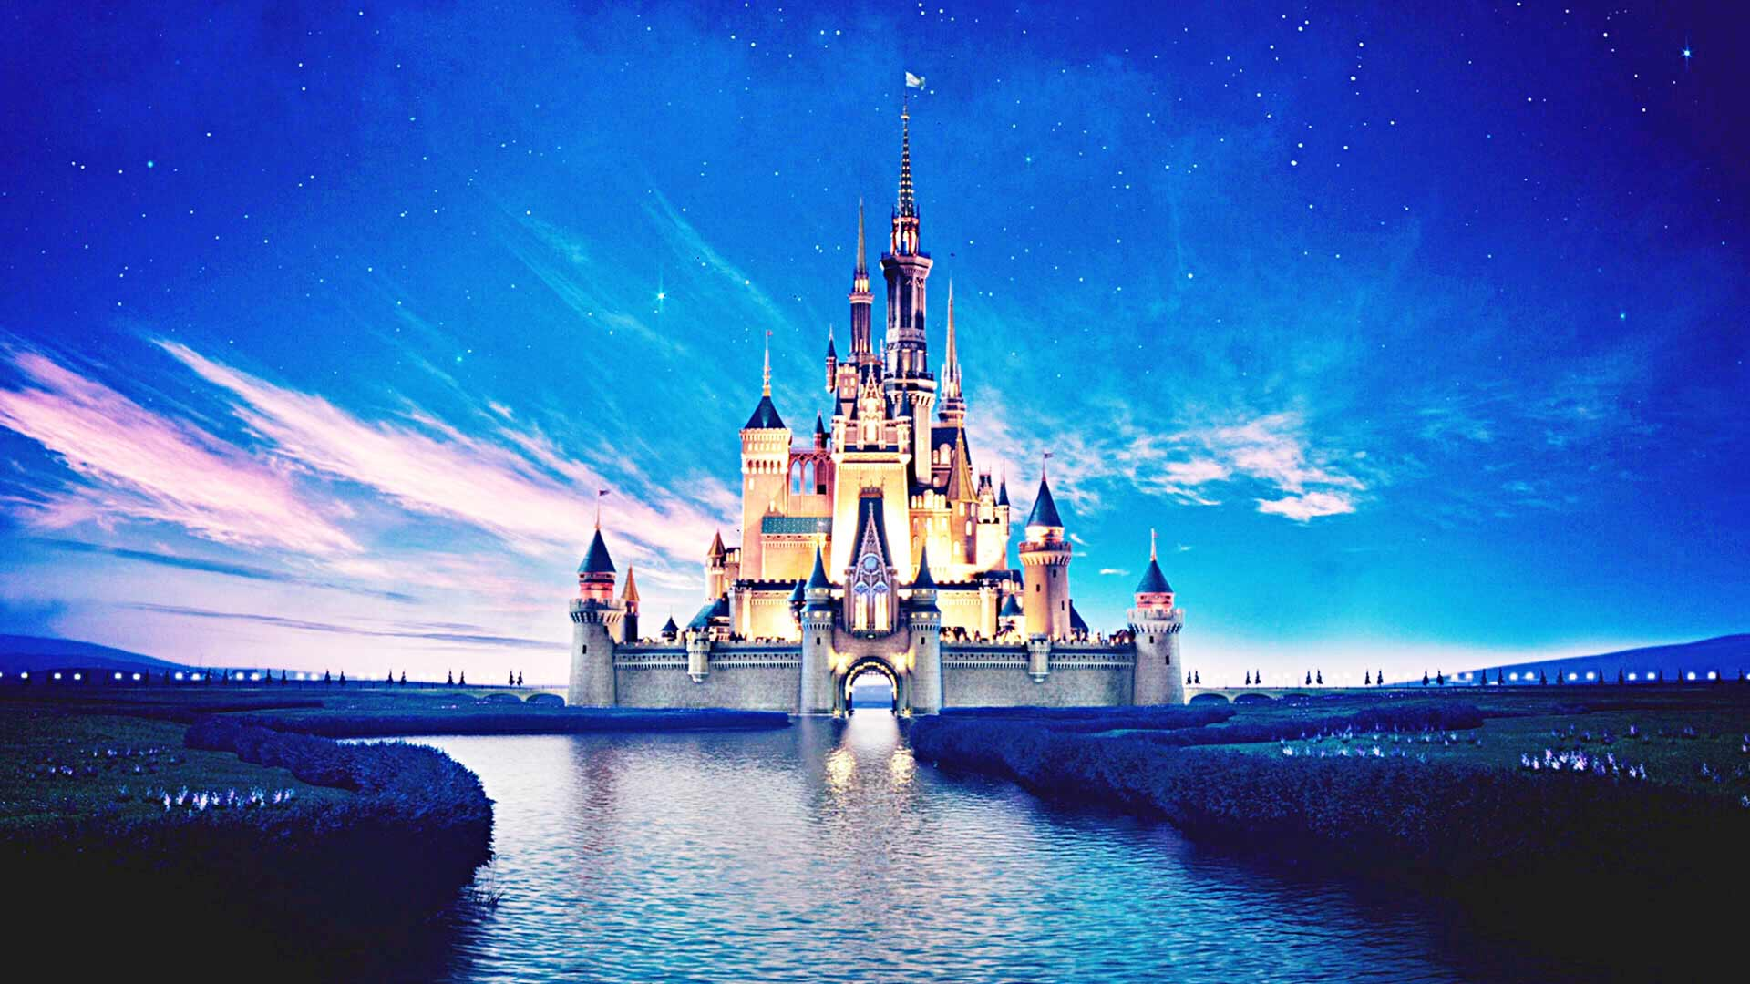
Thank You for coming!

